Slide 1
Bias

Slide 2
Lesson Objectives
By the end of the lesson we will:
Know what Standard English is
Understand what ‘bias’ is
Be able to identify signs of a bias news story

Slide 3
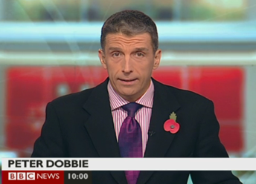
Standard English
A formal style: used in most types of writing and when addressing important people
Firefighters said the ginormous fire was proper hot and dangerous. Onlookers were all like “oh my god!” when the gas canister exploded and bits went everywhere!!

Slide 4
Standard or non-standard?
1. When we done our science experiment the water went all bubbly.
2. I didn’t do nothing!
3. I thought that was lovely.
4.I seen you thump him one on the head!
5. The wind was very cold on Saturday.

Slide 5
Lesson Objectives
By the end of the lesson we will:
Know what Standard English is
Understand what ‘bias’ is
Be able to identify signs of a bias news story

Slide 6
What is bias?
Bias: A one-sided perspective; an inclination towards one point of view

Slide 7
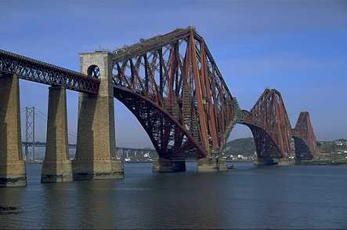
Burglar gets just desserts as man defends home
Homeowner shoots burglar in back as he flees
Daredevil halts traffic
Idiot pulls traffic stunt

Slide 8
Lesson Objectives
By the end of the lesson we will:
Know what Standard English is
Understand what ‘bias’ is
Be able to identify signs of a bias news story

Slide 9
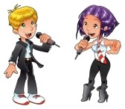
M’Bro singer loses X Factor final
M’Bro Ben loses X Factor final to Bournemouth Beth
Evening Gazette
What will you write about Ben’s performance?
What will you write about Beth’s performance? Bournemouth Echo
What will you write about Beth’s performance?
What will you write about Ben’s performance

Slide 10
St Peter’s school beaten in
St Peter’s Catholic College cricket team returned to Middlesbrough disappointed after [insert word] losing the final of a tournament.
The team played [] and ... to be returning home empty handed.
Their friends and family should be ... their performance.

Slide 11
Lesson Objectives
By the end of the lesson we will:
Know what Standard English is
Understand what ‘bias’ is
Be able to identify signs of a bias news story

Slide 12
Newspapers and their ethics

Slide 13
Paragraphs
Why do we bother?
Lady Gaga emails fan to praise anti-bullying campaign
Lady Gaga has surprised one of her Canadian fans by recording a personal video message in support of his campaign against school bullies. The pop star emailed 17-year-old Jacques St Pierre, praising his efforts to "spread tolerance" by asking pupils to make pledges against bullying. "It is important that we push the boundaries of love and acceptance," she said in the video. The pop star has long been an advocate for anti-bullying laws. Gaga's hit single Born This Way was a call for tolerance. She addressed President Obama on the issue earlier this year, highlighting the case of 14-year-old Jamey Rodemeyer, a US student who took his life after being taunted at school. This month, she announced the formation of a not-for-profit organisation to tackle issues of bullying and abandonment. In her video message to Jacques, she reiterated: "I'm going to be working as hard as I can to make bullying a hate crime". Speaking to Toronto's CBC News, the teenager said he had not been expecting a direct email from the pop star. "The subject line said 'To Jacques from Lady Gaga,'" he told the broadcaster. "It said 'click on the link below to download the video for your assembly'. "I watched it and I started crying. I'm a huge fan. It's kind of embarrassing because I love her so much. I couldn't believe it."
They organise our writing and make it easier to understand

Slide 14
When do we use them?
There are three reasons to start a new paragraph:
When there is a change of topic, place, thought or idea
When there is a change of time
When a new person speaks

Slide 15
Boy – Roald Dahl
When my father was fourteen, which is still more than one hundred years ago, he was up on the roof of the family house replacing some loose tiles when he slipped and fell. He broke his left arm below the elbow. Somebody ran to fetch the doctor, and half an hour later this gentleman mad a majestic drunken arrival in his horse-drawn buggy.
“We’ll soon put this back into place” he cried out, and two men were called off the street to help with the pulling.

Slide 16
Whispers in the Graveyard
Sheltering under the leafy tree prevented Sol from the torrential downpour that had begun so suddenly.
After the rain had eased, Sol convinced himself that he should visit the far corner that he called his own. Taking care that his shadow was not visible in the dim street lights shining from the roadside, Sol crept over, making sure that he stayed as close to the wall as he could.
“Dare you to run through the graveyard,” the young voice challenged.
“Not tonight, it’s too wet.”

Slide 17
Definition
Ethics are a person’s standards concerning what is acceptable and what is not acceptable to do

Slide 18
Some newspaper ethics
Give those involved a chance to give their point of view
Don’t reveal the names their informants
Only write stories that are of ‘public interest’
Respect privacy

Slide 19
The South Bank Star
You hear that a loveable children’s TV star was taking illegal drugs at a party in their home last night. Your informant suggested there could be proof in their dustbin. Do you send someone to search for evidence and grab the headline?
NO
YES

Slide 20
The South Bank Star
You hear that a loveable children’s TV star was taking illegal drugs at a party in their home last night. Your informant suggested there could be proof in their dustbin. Do you send someone to search for evidence and grab the headline?
NO
YES
Your main rival paper gets the story and sells loads of copies! You get a similar ‘lead’ from the same informant about another TV star. Do you run the story this time?
NO
YES
Your rival is sued for breaching privacy, gets a big fine and loads of bad publicity. Good choice!!

Slide 21
The South Bank Star
You hear that a loveable children’s TV star was taking illegal drugs at a party in their home last night. Your informant suggested there could be proof in their dustbin. Do you send someone to search for evidence and grab the headline?
NO
YES
Your main rival paper gets the story and sells loads of copies! You get a similar ‘lead’ from the same informant about another TV star. Do you run the story this time?
YES
You and your rival are sued for breaching privacy, get a big fine and loads of bad publicity. Oops!!

Slide 22
WORDS WORDS WORDS WORDS
MORE WORDS
MORE WORDS
Someone’s name
Lots of words. Lots of words. Lots of words. Lots of words. Lots of words. Lots of words. Lots of words.
Lots of words. Lots of words. Lots of words. Lots of words. Lots of words. Lots of words. Lots of words. Lots of words. Lots of words. Lots of words. Lots of words. Lots of words.
Image Byline Masthead Headline
Text Strapline Banner Lead paragraph

